Slide 1
MBTI
Detector
Project Proposal
200103413
Yrsymbet Meruyert

Slide 2
TABLE OF CONTENTS
01
PURPOSE
02
DATA SOURCE
03
CLASS IMBALANCE
04
FINDING CORRELATION
05
FEATURE ENGINEERING
06
ML MODELING
07
FEATURE IMPORTANCE
08
CONCLUSION

Slide 3
01.
ABOUT THE PROJECT

Slide 4
PROJECT PURPOSE
The purpose of this project is to apply machine learning classification and natural language processing algorithms to examine if a person’s MBTI traits correlates with his/her style of writing on the forums.

Slide 5
02.
DATA SOURCE

Slide 6

ABOUT THE DATA
The publicly available Myers Briggs personality type dataset on Kaggle was used for this project. This dataset contains over 8675 rows of data. On each row is a person’s:
Type (4 letter MBTI code/personality type)
A section of each of the last 50 things they have posted (Each entry separated by "|||" (3 pipe characters))

Slide 7
03.
CLASS IMBALANCE

Slide 8
To handle the class imbalance issue, the following two steps were taken:
1. First step was to divide the single “type” feature into four features:
2. The second step was to use random under sampling technique when building machine learning model. This is covered in step 6.
Extroversion vs. Introversion
I - 0
E - 1
Sensing vs. Intuition
N - 0
S - 1
Thinking vs. Feeling
F - 0
T - 1
Judging vs. Perceiving
P - 0
J - 1

Slide 9
04.
FINDING CORRELATION

Slide 10

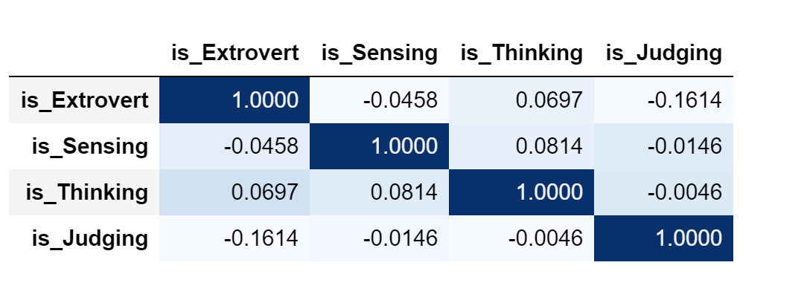
Pandas correlation method was used to plot the correlation matrix to find any strong correlations between any of the four personality features. The plot shows that the features didn’t not show any strong correlation.

Slide 11
05.
FEATURE ENGINEERING

Slide 12
Cleaning the Data
Following steps were taken to prepare the data for machine learning models:
Posts were converted into lower case.
||| and punctuations were replaced by spaces.
Links and Emails were dropped.
MBTI personality types were dropped. There was quite a few uses of these types in the posts and we didn’t find them adding any value.
Words with one to two character length were dropped.
The cleaned data generated after executing above steps was Lemmitized using NLTK Word Net Lemmitizer. Stop Words were dropped at this stage.
The result of these steps stored as “clean posts” was cleaned and lemmatized set of words for each user.

Slide 13
Sentiment Scoring
Part of Speech Tagging
Counting
Following steps were taken to prepare the data for machine learning models:
Sentiment Intensity Analyzer was used to calculate compound, positive, negative and neutral sentiment score for each user using the clean posts.
NLTK POS tagger was used to tag each word with its part of speech tag. The average number of each of the POS tags was calculated for each user based on the original posts. The POS tags included were – Noun, Pronoun, Verb, Adverb, Adjective, Conjunction, Determiners, Numbers, Prepositions, Particles and Punctuations.
Per user average counts were taken for number of question marks, exclamations, colons, emojis, words, unique words, upper case words, links, ellipses and images. These counts were our additional features for the machine learning models covered in step 6.

Slide 14
06.
ML MODELS

Slide 15
This was our final step. Various classifications models were used in this step on the dataset.
1.The data was split into X (input features) and y (target).
3. Since the data was imbalanced Imbalance Learn Pipeline was used to create the models. The pipeline was composed of preprocess (from the above step), random under sampler (to handle class imbalance) and the classification model.
2. Preprocessing step was designed to vectorize the clean posts and to select k best features out of the other (non-word) features using column transformer.
4. Following models were built, trained and tested on dataset:
X comprised of clean posts, compound sentiment score, pos tag counts, and various other counts.
Y was set to four target features - is_Extrovert, is_Sensing, is_Thinking, is_Judging

Slide 16


4. Following models were built, trained and tested on dataset:
TF-IDF Logistic Regression
Count Vectorized Logistic Regression
TF-IDF Logistic Lasso
Count Vectorized Logistic Lasso
TF-IDF Logistic Ridge
Count Vectorized Logistic Ridge
TF-IDF Logistic Elasticnet
TF-IDF Support Vector Classifier
Count Vectorized Support Vector Classifier
TF-IDF Naive Bayes
Count Vectorized Naive Bayes
TF-IDF Random Forest
Count Vectorized Random Forest

Slide 17
5. Evaluation Metrics – Accuracy, Precision, Recall, ROC-AUC and Average Precison_Recall_Score were used as the measures to evaluate the models and select the one performing the best.
6. Final Model – Based on the scores for the evaluation metrics used, TF-IDF Logistic Regression Model was selected as the final model for predicting Myers Briggs personality type.

Slide 18
07.
FEATURE IMPORTANCE

Slide 19
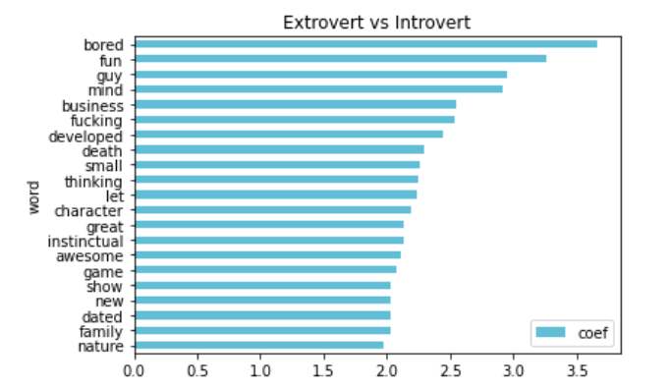
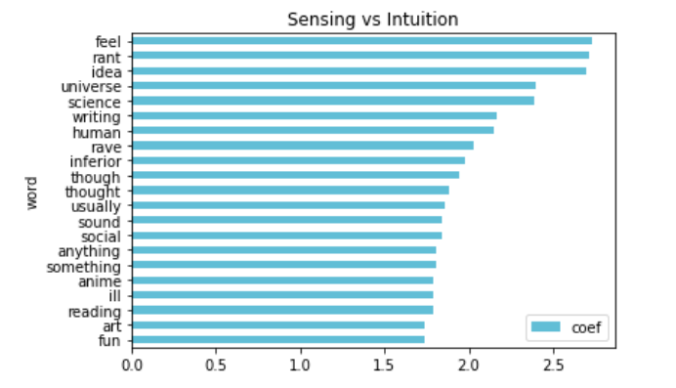
Using Logistic Regression coefficients, we did feature importance and plotted top 20 words used by each of the 4 Myers Briggs traits.

Slide 20
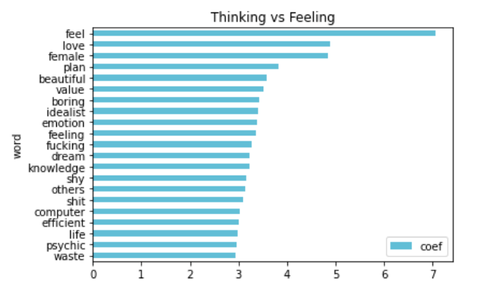
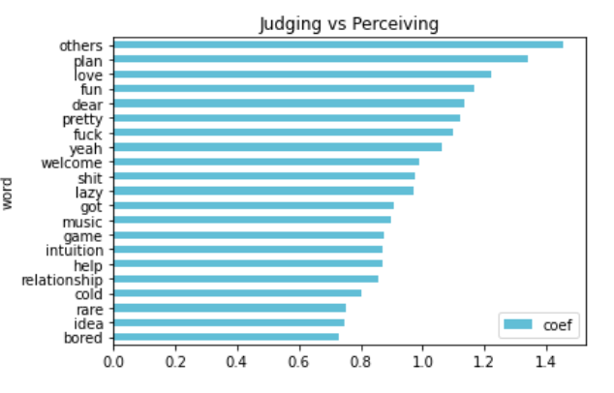
Using Logistic Regression coefficients, we did feature importance and plotted top 20 words used by each of the 4 Myers Briggs traits.

Slide 21
Stephen Hawking. Theoretical physicist
“The human race is just a chemical scum on a moderate-sized planet, orbiting around a very average star in the outer suburb of one among a hundred billion galaxies. We are so insignificant that I can't believe the whole universe exists for our benefit. That would be like saying that you would disappear if I closed my eyes.”

Slide 22
The dataset was heavily imbalanced with most people identifying as introverted (I) and Intuitive (N) rather than extroverted (E) and Sensitive (S). This caused all our models to have a hard time classifying Extroversion vs. Introversion and Sensitivity vs. Intuition. We were able to overcome this problem to some extent by using Imbalance Learn’s Random Under Sampling method. This improved the scores but not significantly. We also added extra words that didn’t seem to be very helpful in classifying a personality trait to the stop words list to make the model predict more efficiently. Our model is able to predict 2 to 4 traits out of a total of 4 traits and we consider this as success because even for human readers it is difficult to accurately predict a person’s Myers Briggs personality type.
In our future efforts to improve this model, we plan to add more data specifically for the types that have low counts in our current dataset to balance the classes. We also want to implement a neural network based model in an attempt to see if that can outperform our current model in accurately predicting all 4 traits of the Myers Briggs personality type.
CONCLUSION

